Slide 1
Entity-Based Document Classification on the CORD - 19 Corpus
Gollam Rabby and Tomas Kliegr
Department of Information and Knowledge Engineering, VSE University, Prague, Czech Republic

Slide 2
Project
1. Transforming CORD-19 to a flat csv file (e.g. with resources corresponding to columns) to which standard rule learning tools/algorithm can be applied. 2. The task is to predict the (academic) success of a paper (as measured by citations).
3. Since we use an "explainable" machine learning tool/algorithm, we could find which combination of concepts (e.g. chemical substances) is predictive of paper success.
<number>

Slide 3
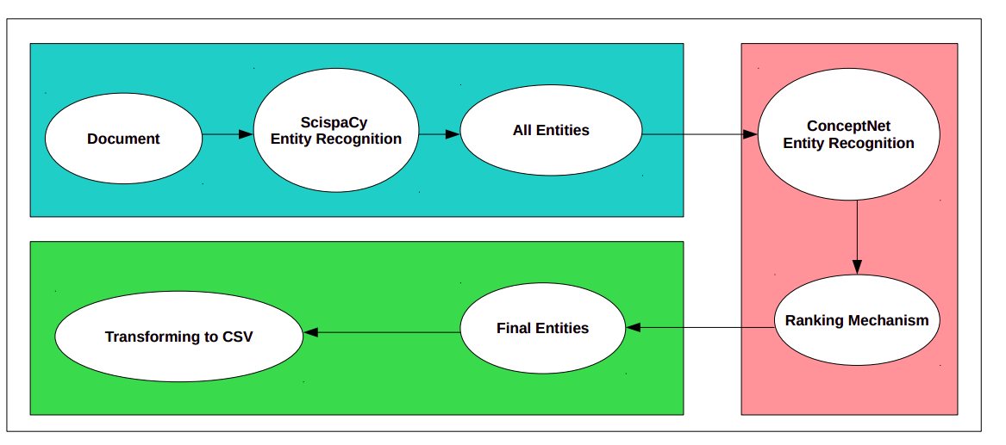
Project - Pre-processing data
<number>

Slide 4
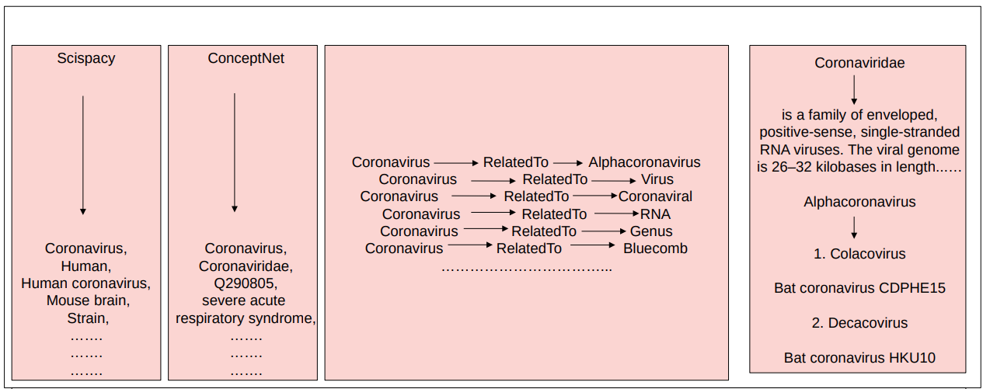
<number>

Slide 5
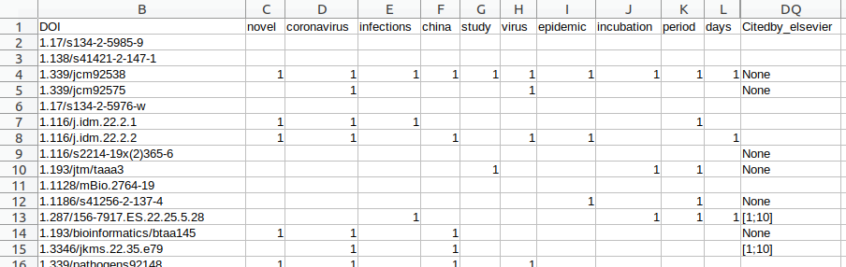
Mining from Tabular: Result of preprocessing
<number>

Slide 6
Mining Tabular: Example results of rule mining (Bayesian Rule Set mining)
Antigenic & Antitoxin and Cold OpenCitations_Ontology([10;100])
Antigenic & Annual OpenCitations_Ontology([10;100])
DNA & Antigenic & Diagnosis OpenCitations_Ontology([10;100])
Information & Annual & Diagnosis OpenCitations_Ontology([10;100])
DNA & Years & Diagnosis OpenCitations_Ontology([10;100])
Antigenic & Years & People OpenCitations_Ontology([10;100])
Epidemic & Clinical manifestations OpenCitations_Ontology([10;100])
Middle east respiratory syndrome coronavirus & Effective OpenCitations_Ontology([10;100])
<number>

Slide 7
Summary
1. Ways to generate higher quality entities, assign weights to entities, remove uninteresting entities. Currently, we have experimented with Scispacy, ConceptNet, Scispacy with ConceptNet and TF-IDF model.
2. We use a number of citations (OpenCitations Ontology) as a proxy of the significance of results reported in the paper. Do you have a better suggestion?
3. Use SBRL, CORELS and Random Forest for finding the combination of concepts from research papers.
<number>

Slide 8
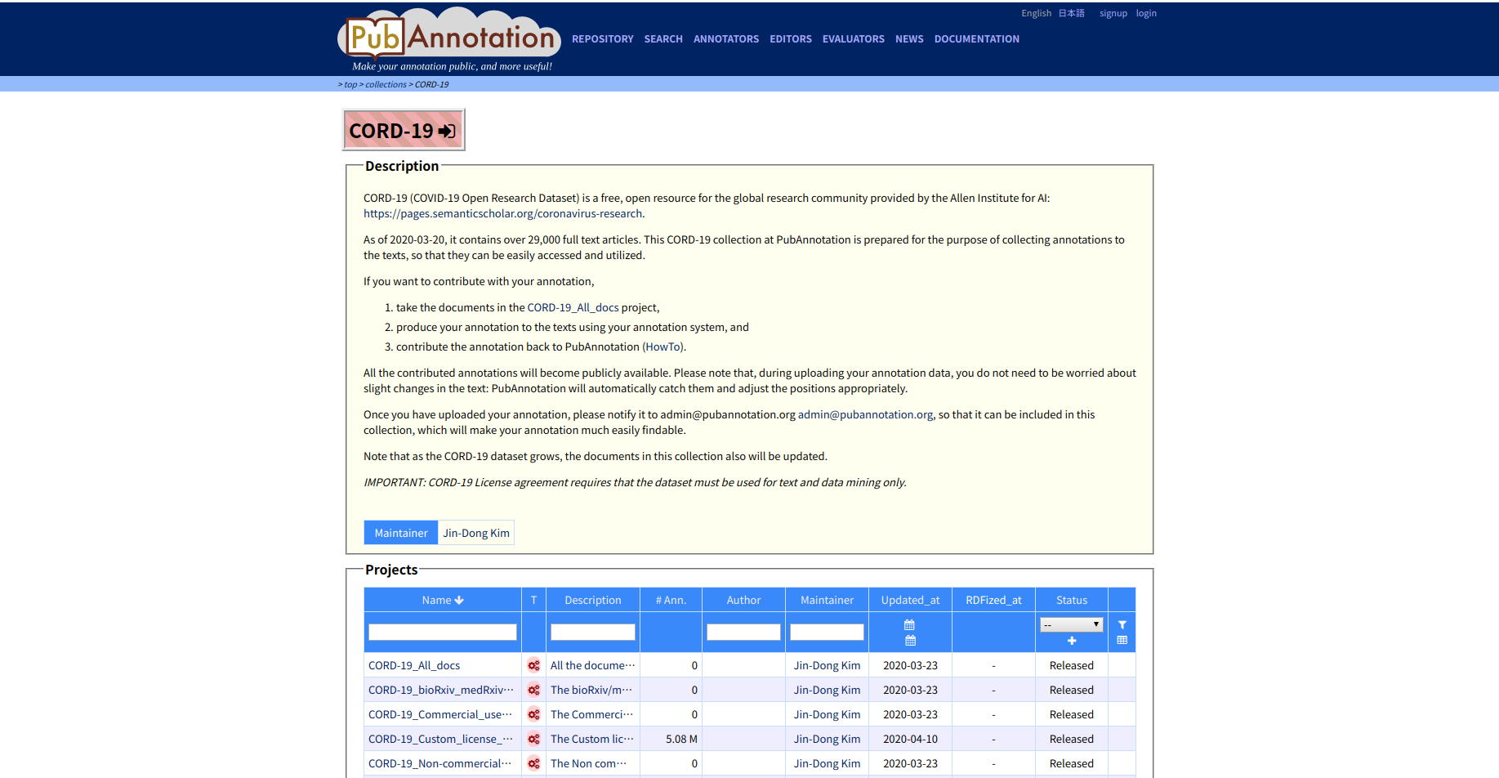
Future Work - PubAnnotation
[1] http://pubannotation.org/collections/CORD-19

Slide 9
Future Work - Mining data with RDFRules
Mine only logical rules with default thresholds
COVID19 KG
TRIPLES
Exported
Rules
<number>

Slide 10
Future Work – Demo Results
(?a <https://www.ica.org/standards/RiC/ontology#publishedBy> <http://dbpedia.org/resource/Elsevier>) ^ (?b <http://www.w3.org/1999/02/22-rdf-syntax-ns#type> <http://dbpedia.org/ontology/ChemicalCompound>) -> (?a <http://idlab.github.io/covid19#hasConcept> ?b) | support: 81987, headCoverage: 0.04837402115577961, headSize: 1694856
(?a <http://www.w3.org/1999/02/22-rdf-syntax-ns#type> <http://purl.org/spar/fabio/JournalArticle>) ^ (?b <http://www.w3.org/1999/02/22-rdf-syntax-ns#type> <http://dbpedia.org/ontology/ChemicalCompound>) -> (?a <http://idlab.github.io/covid19#hasConcept> ?b) | support: 161969, headCoverage: 0.09556505095418136, headSize: 1694856
(?a <http://www.w3.org/1999/02/22-rdf-syntax-ns#type> <http://purl.org/spar/fabio/Work>) ^ (?b <http://www.w3.org/1999/02/22-rdf-syntax-ns#type> <http://dbpedia.org/ontology/ChemicalCompound>) -> (?a <http://idlab.github.io/covid19#hasConcept> ?b) | support: 178542, headCoverage: 0.10534346280745975, headSize: 1694856
<number>

Slide 11


